Slide 1
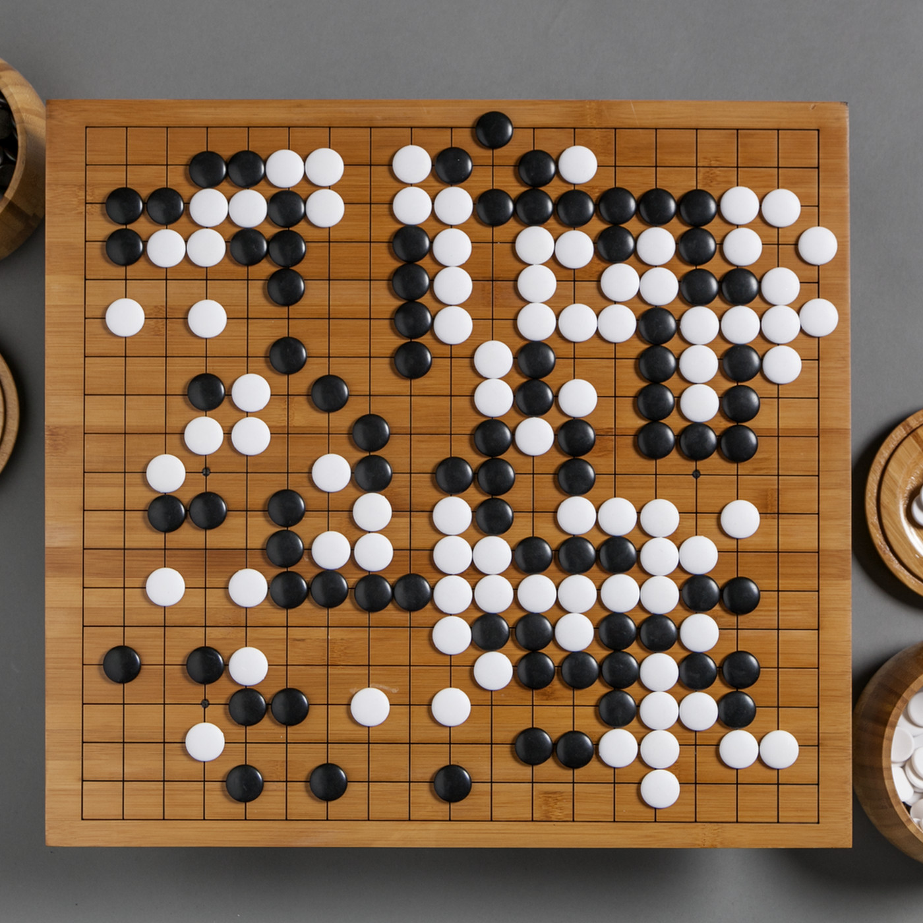
CSCI 599: ZeroGo
Solving the game of Go with ML
Sunny Patel
Jing Ouyang
Wesam Alwehaibi

Slide 2
What we did last week?
Explore heuristics that could be applied toward improving the final agent.
Finding strategies used by players across the globe by reading blogs, interviews and observations.

Slide 3
What we did last week?
Continue Training Actor Critic agent
Actor Critic agent showed improvement against a random agent after 21,000 self play games and 21 iterations for a very small board (5x5)
Using a pure actor critic agent makes the learning process very slow even for a very small board
Assuming unlimited time/resources, the agent has the potential to show more improvement
Hence, Actor Critic agent is put on hold for now

Slide 4
What we did last week?
Improved the Performance of the value agent
value agent: evaluate how much in advance or behind its opponent
Original value agent:
Reward 1 for win, -1 for lose for every step
Cannot learn to predict its advantage
Improved value agent:
Discount the reward for early game
Early game in Go: no obvious advantage
Reward 0 for the first 30 steps, with discounted reward after that until the full reward in the late game (>150 steps)

Slide 5
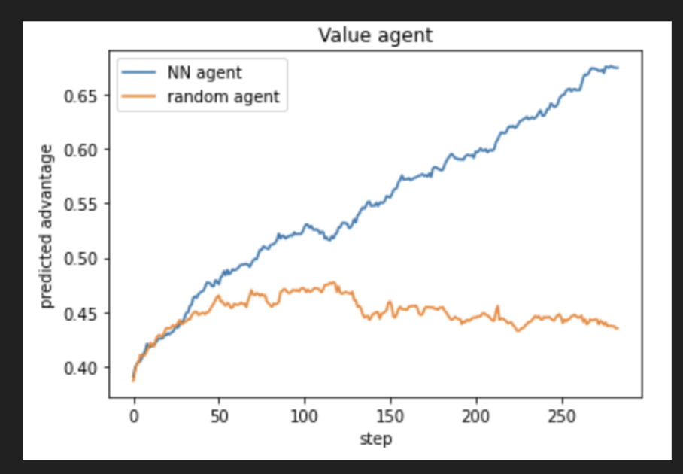
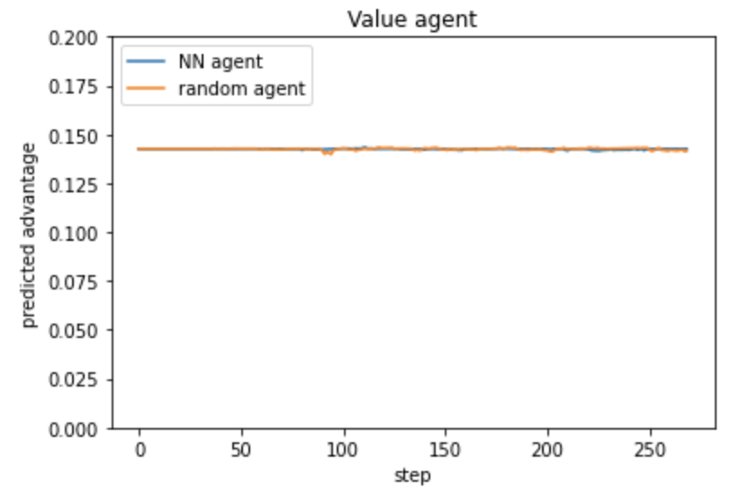
What we did last week?
Original value agent
Improved value agent

Slide 6
What we did last week?
Integrate previously developed agents in alphago style
MCTS:
Read ahead
Policy Agent:
Select move
Value Agent:
Judge advantages
Heuristics:
Experiences

Slide 7
What do we plan to do next?
Focusing on the integrated agent
Continue Improving policy agent and value agent
Continue exploring more heuristics
Continue improving the integrated agent
Continue developing the UI
Work on deploying the UI as a web service

